Slide 1
.
Kollipara Aasritha Veera Raga Sai
Final Project
3/21/2024 Annual Review

Slide 2

Key Logger and Security
A keylogger is a programme or tool designed to monitor and keep a tab on the “keystrokes” made on the user keyboard.
This enables on compromising sensitive data like passwords etc…
Keyloggers are programs that covertly record keyboard inputs.
3/21/2024 Annual Review

Slide 3


AGENDA
Problem Statement
Project Overview
Who Are The End Users
Solution And Its Value Proposition
The Wow in Your Solution
Modelling
Outputs
Results
Project Links
3/21/2024 Annual Review

Slide 4

PROBLEM STATEMENT
The problem statement is that the keyloggers can be detected using antiviruses.
Installation of hardware keyloggers is difficult without the knowledge of the owner of the system.
We can build a software keyloggers instead of hardware keyloggers.
Overview of Keylogger Detection and Prevention Strategies.
Importance of Developing Effective Solutions in the Cybersecurity Landscape.
3/21/2024 Annual Review

Slide 5

PROJECT OVERVIEW
The Keylogger Monitoring Tool has been developed specifically to solve numerous problems of modern security and productivity in the modern world. It addresses companies struggling with internal security breaches, anxious parents who want to monitor their children’s internet activity, and organizations in need of protection from unauthorized access.
Security Enhancement: To help the executives protect their privacy and information security, the tool provides a safe way of recording keystrokes to prevent data leaks, sabotage, and unauthorized access within the company.
Parental Control: Parents are able to oversee and regulate their children’s usage of the computers, and steer clear of improper conducts online.
User-Friendly Interface: The tool aims to remove traditional keylogging solutions by focusing on convenient browsing without loss of security or capabilities.
3/21/2024 Annual Review

Slide 6

WHO ARE THE END USERS?
Organizations and IT Administrators
Security Professionals
IT Administrators
Parents and Guardians
Individual Users
3/21/2024 Annual Review

Slide 7

SOLUTION AND ITS VALUE PROPOSITION
Security Awareness : Awareness about phishing scams, social engineering tactics, and safe computing practices can help.
Regular Software Updates : Keeping the OS, Antivirus software, web browsers, and other applications up to date helps to protect against keyloggers attacks.
Virtual Private Network (VPN) : Encrypts internet connection and protect your keystrokes from being intercepted while typing online.
Secure Operating Systems : Choosing a secure OS that prioritizes security features and regular updates can help mitigate the risk of keyloggers and other malware.
Biometric Authentication : Fingerprint scanners or facial recognition for authentication adds an extra layer of security, making it harder for keyloggers to compromise your credentials.
3/21/2024 Annual Review

Slide 8

THE WOW IN YOUR SOLUTION
Real-time Security Monitoring: Implementing real-time monitoring of website traffic and user interactions to detect suspicious behavior or potential security threats, such as SQL injection attempts or XSS (Cross-Site Scripting) attacks.
Biometric Authentication : Enhance security with biometric authentication methods
Client-side Security Measures: Deploying client-side security measures, such as script monitoring and integrity checks, to detect and prevent unauthorized modifications to website scripts or injected malicious code.
Two-Factor Authentication : Implement two-step verification to add an extra layer of security beyond passwords, thwarting keyloggers from compromising your accounts.
3/21/2024 Annual Review
8

Slide 9
MODELLING
Install required python libraries in command prompt like,
1. pip install pynput
2. pip install json
Initialization of Keylogger Set up the main GUI window and initialize the global variables for key logging.
Capturing of keystrokes Start capturing key events when the ‘Start’ button is pressed. Log key press and release events.
Data Logging into text files Update text and Json log files with captured key events.
Stop Logging Stop capturing key events when the ‘Stop’ button is pressed.
3/21/2024 Annual Review
9

Slide 10
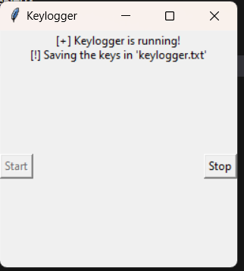
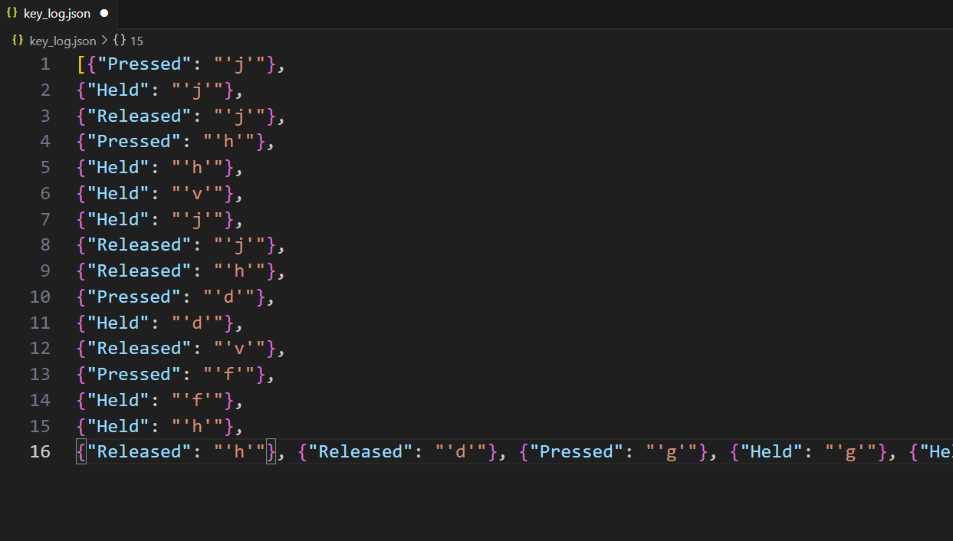
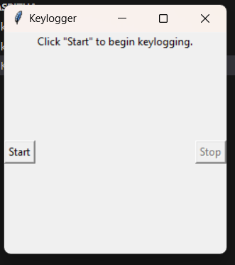
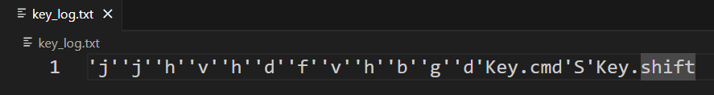
RESULTS
3/21/2024 Annual Review
10

Slide 11
GitHub Link
https://github.com/aasritha04/KeyLogger.git

Slide 12








